Slide 1
”DIKSHA” Sundaram Fin.Tech 2025
Journey Presentation –week 2
Anil Rasa
Date : 22-Feb-2025

Slide 2

Topics Covered in Second Week !

Slide 3
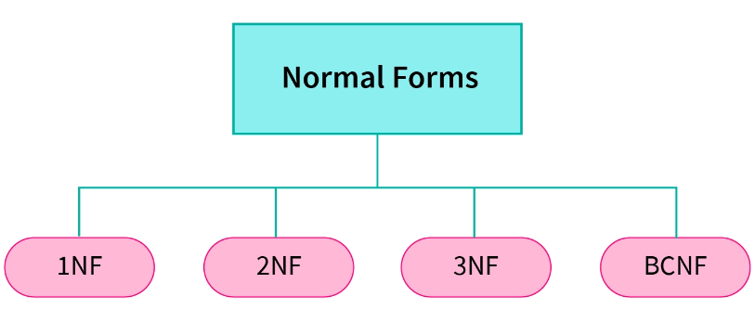
Learning 1 | My takeaways
→ NORMALIZATION
→ QUOTE OPEREATIORS
→ORDER BY CLAUSE
→FUNCTIONS
1)SINGLE ROW
2)MULTI ROW
→ TYPES OF SINGLE ROW FUNCTIONS

Slide 4
NORMALIZATION : Normalization is a process of arranging the data and also avoid the data redundancy.
1)1NF : Each column should have a appropriate value data and each cell should have a single value.
2)2NF :1NF And there exists no partial dependency.
3)3NF: 2NF And there exists no transitive dependency.
4) BCNF: A relation is in BCNF if and only if for every one of its non-trivial functional dependencies X → Y, X is
a super-key.
5)4NF: A table is in 4NF if it is in BCNF and it has no multi-valued dependencies.
6)5NF:A relation is in 5NF if every non-trivial join dependency in R is implied by the candidate keys of R.
QUEOTE OPERATOR: If we use two quotes in a single quote then it is applicable.
ex:- select e_name||Q’(work’s as )’|| from employees
ORDERBY CLAUSE: The order by keyword sorts the records in ascending order by default.
→ASC: Ascending order.
→DESC : Descending order.
CONDITIONAL EXPRESSION: provide use of the IF-THEN-ELSE logic with a SQL statements.
here we use two methods
1)CASE EXPRESSION
2)DECODE FUNCTION
FUNCTIONS: we have two types of functions.
Single row →a)Character b)General c)Number d)Conversion e)Date
Multi row → Multi row function are aggregate a) Avg b)Count c)Max d)Min e)Stddev f)Sum g)Variance
Q

Slide 5

Learning 2| My Takeaways
→CONVERSION FUNCTIONS
→AGGREGEATE FUNCTIONS
→ GROUP BY CLAUSE
→JOINS

Slide 6
CONVERSION FUNCTIONS: Conversion functions are the one of the single row functions.
conversion functions are used to convert from one data type to another data type.
Types of conversion 1) Implicit conversion –happen automatically by oracle server
2)Explicit conversion – we have 1)To_date 2)to_char 3)To_number
Nested functions: The function which is written inside another function.
Ex:- select last_name,upper(concat(substr(last_name,1,3),’_devara’) from employees;
General→ NVL-convert null value to actual value.
Conditional expression : provide the use of IF-THEN-ELSE logic with a SQL statement.
Aggregate functions(Multi row functions): 1)avg 2)max3)min4)count5)stddev 6)sum 7)Variance
Syntax:-1)select avg(salary) from employees;
2)select count(*) from employees;
JOINS: a join clause is used to combine rows from two or more tables.
types of join→1)natural join 2)inner join 3)self join 4)outer join
→1)left outer join
→2)right outer join
→3)full join

Slide 7
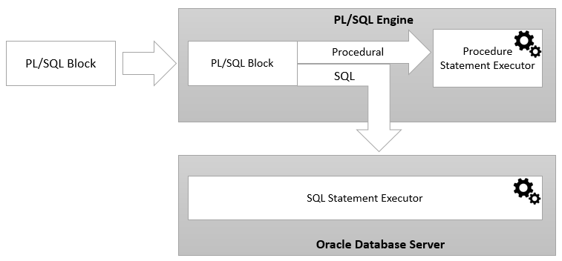
Learning 3| My takeaways
→SUB QUERIES
→MULTIROW SUB QUERIES
→PL/SQL
→BLOCK TYPES
→LOOPS

Slide 8
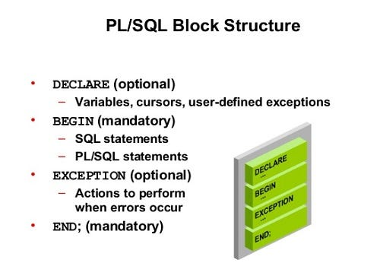
SUB QUERIES:A query with in the another query then it is said to be a sub query. Better to use subquery inside the parenthesis.
Ex:- select max(salary) from employees where salary<(select max(salary) from employees)
Multi-row Subqueries: 1)IN 2)ANY 3)ALL
PL/SQL: PL/SQL stands for procedural language extension to SQL.
Block types:- 1)Anonymous- The block doesn’t have any particular name
2)Procedure - here we give name
3)Function- it is same as procedure but here return data type.
Scalar datatype: a variable holds a single value.
PL/SQL Control Statements: PL/SQL has three categories of control
statements: conditional selection statements, loop statements.
Conditional statements:1)IF THEN 2)IF THEN ELSE
3)IF THEN ELSIF THEN END IF 4)CASE WHEN…..THEN ELSE END
CASE
LOOP: Loops are used to execute the no.statements no.of times as per the application requirements.
1)Basic loop 2) for loop 3)while loop

Slide 9
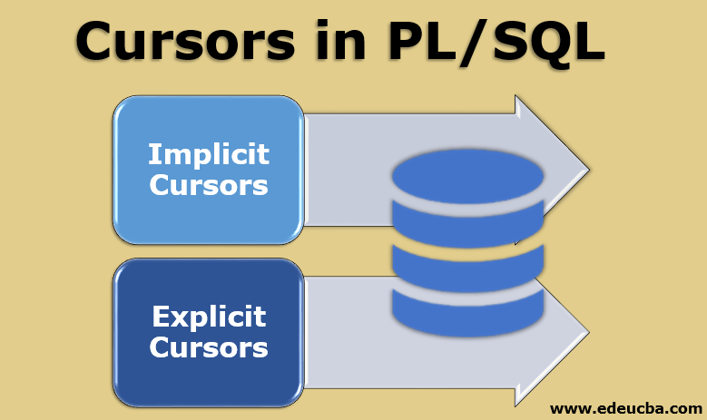
Learning 4 | takeaways
→Types of Cursors
→Exceptions
→Procedures

Slide 10
CURSOR: Cursor is a pointer to private area allocated by all the oracle server .it is used to handle the result set of a select statement.
Types of cursor:
1)Implicit → Create and managed internally by oracle server process SQL statements.
2)Explicit → Declared explicit by programmer.
Types of cursor attributes: 1)%FOUND 2)%NOT FOUND 3)%IS OPEN 4)%ROW COUNT
EXCEPTIONS: Exception is a PL/SQL error that is raised during program execution.
1)Implicit: implicit exception is done by oracle server.
2)Explicit: Explicit exception is written by programmer.
→Predefined exceptions are 1)Zero divide 2)No data found 3)To many rows 4)Invalid cursor
Procedures:
A SQL procedure is a pre-written, reusable code block designed to perform a specific task or set of tasks.
Anonymous: anonymous block is complied every time.Data not stored in the database.Cannaot be involved by other applications ,Do not return values.
Sub programms:
Named pl/sql block complied only once,stored in database ,named can be involked by other applications ,if functions must return values can take parameter.

Slide 11
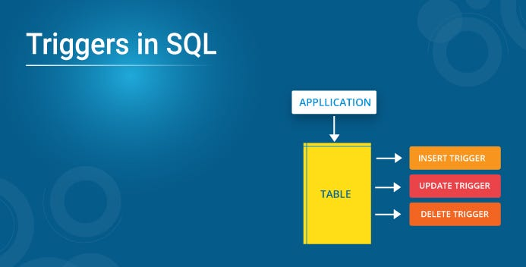
Learning 5 | Takeaways
→Functions
→Triggers

Slide 12
Functions:In PL/SQL, a function is a set of statements that performs a task by accepting inputs, performing an action, and returning a result.
Syntax: create or replace function function_name
Ex:-CREATE OR REPLACE FUNCTION CALCULATE_FACTORIAL(n IN NUMBER) RETURN NUMBER IS
Fact NUMBER :=1;
BEGIN
FOR i IN 1..n LOOP
fact:=fact*i;
END LOOP;
RETURN FACT;
END;
Triggers: PL/SQL triggers are block structures and predefined programs invoked automatically when some event occurs.Types of triggers: 1)Row level trigger 2)Statement trigger
Syntax for create trigger: create trigger trigger_name(After|Before) (Insert|Update|Delete) ON
begin
--variable name
--trigger code
end;
NEW is a pseudo-record name that refers to the new table row for insert and update operations in row-level triggers. Its usage is :NEW.
OLD is a pseudo-record name that refers to the old table row for update and delete operations in row-level triggers. Its usage is :OLD.

Slide 13
Thank You

